Slide 1
Transformative Planning
Health Administration Press
How Your Healthcare Organization Can Strategize for an Uncertain Future
Jim Austin

Slide 2
Introduction
This “workbook” is for healthcare leadership teams that are grappling with transformative change, while also seeking to improve current operations.
Slides/worksheets correspond to chapters of the book, Transformative Planning.
Utilize these resources as guides for discussion, not as rigid checklists.
—Jim Austin

Slide 3
Overview
Overall Transformative Planning Framework
Chapter 1: Mental Models and Strategic Decision Making
Chapter 2: Front and Back—Vision and the Strategic Pyramid
Chapter 3: Strategy Development for a VUCA World—Scenario Planning
Chapter 4: Successful Execution
Appendix: Indicative Planning Timeline and Prioritization Worksheets

Slide 4
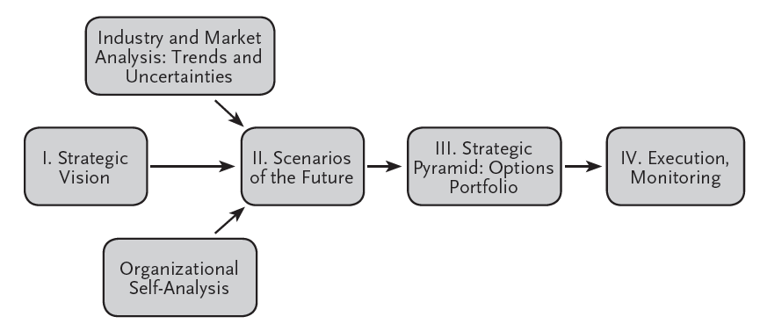
Overall Transformative Planning Framework
Four-Step Process for Leading Transformational Change: Meeting the Needs of Today and the Future
Notes:
Repeatable
Disciplined
Creative
Comprehensive
Externally driven
DSI has authored world-recognized strategy methodologies tested and proven across hundreds of client environments
Process is accessible, disciplined and flexible
Results in options approach to strategy, broader understanding of vision, actions and outcomes

Slide 5
Chapter 1: Mental Models and Strategic Decision Making
Summary Questions
1. Framing/assumptions
(a) Why was the institution successful in the past?
(b) What needs to be done to be successful in the future?
(c) What could disrupt these ideas or perspectives?
2. Confirmation bias/overconfidence
(a) Is the leadership team relying on an overly narrow, shared view of the future?
(b) How can the leadership team gain fresh insights to broaden its strategic planning assumptions and perspectives?
(c) What can be done to leverage viewpoints inside and outside of the institution or group to challenge the tendency to focus on data that confirm existing beliefs?

Slide 6
Chapter 1: Mental Models and Strategic Decision Making
Summary Questions (continued)
3. Groupthink
(a) How will prevailing beliefs be challenged?
(b) Are all the points of view in the leadership team being surfaced and heard?
(c) What are the steps to reaching consensus? What will be the decision-making process?
4. Attribution bias
(a) What are the success metrics in broad terms for the strategic planning effort?
(b) How will progress to date be assessed, and how will the need to shift investments, people, and resources be triggered if circumstances change?
(c) How will the leadership team avoid the sunk-costs syndrome of spending more and more resources on losing strategic initiatives?

Slide 7
Chapter 2: Vision and the Strategic Pyramid
Critical Questions
What are the aspirational hopes or goals of the organization?
What would the world lose if the organization ceased to exist?
Why should any stakeholder (internal or external) want to belong?
What are the critical, unique values that the organization supports even if doing so leads to a competitive disadvantage?
Creating a Vision Statement
“The . . . ”? Who are you? How are you identified?
“is . . . ”? What are you? What is the nature of your group?
“that . . . ”? What do you do? What products or services do you offer?
“for . . . ”? Whom do you serve? Are your clients /customers internal, external, or both?
“to . . . ”? Why do you exist? What value do you bring to your clients/customers?

Slide 8
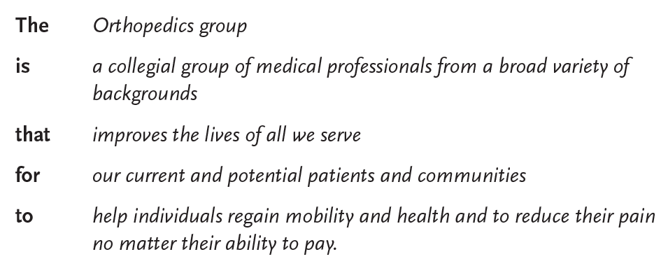
Example at a Subspecialty Level
Chapter 2: Vision and the Strategic Pyramid

Slide 9
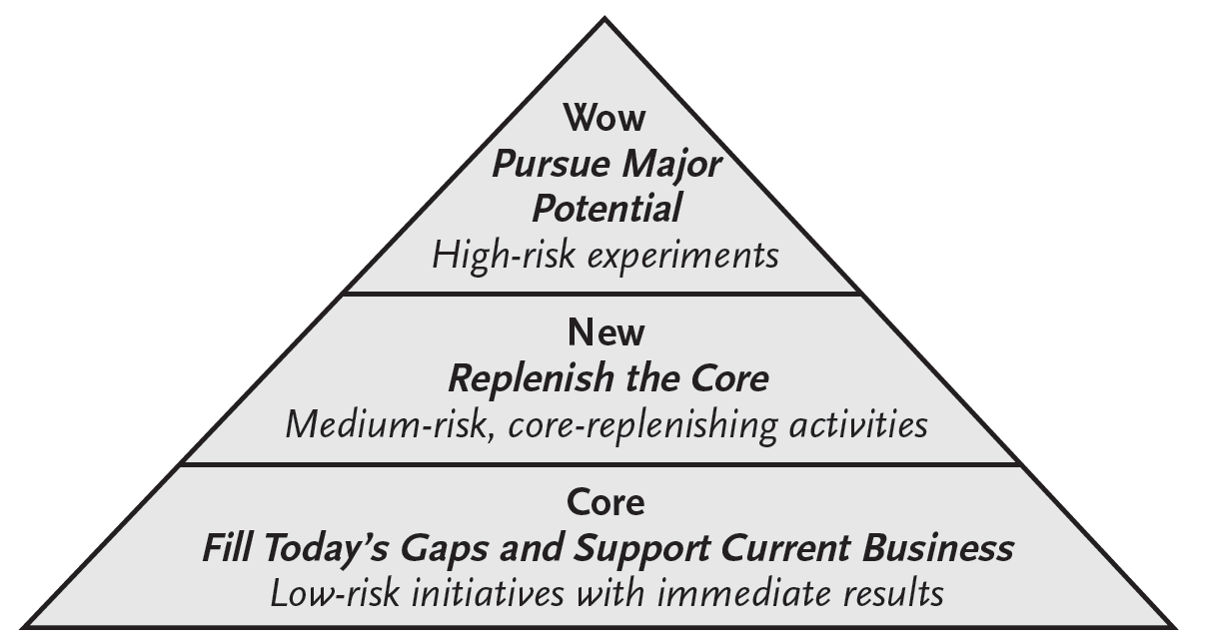
Chapter 2: Vision and the Strategic Pyramid
What are the mission-critical strategic choices in the short-, medium-, and long-term time frames? How is success defined in these periods?

Slide 10
Chapter 2: Vision and the Strategic Pyramid
Summary Questions
1. Vision
(a) What are the aspirational hopes or goals of the organization?
(b) What would the world lose if the organization ceased to exist?
(c) Why should any stakeholder (internal or external) want to belong?
(d) What are the critical, unique values that the organization supports even if doing so leads to a competitive disadvantage?
2. Strategic pyramid
What are the mission-critical strategic choices in the short-, medium-, and long-term? How is success defined in these periods?
Core. What short-term, relatively low-risk investments and strategic initiatives must be undertaken to keep the current organization functioning? How can core operations be made increasingly efficient to free up resources for investing in transformative (new and wow) initiatives?
New. What medium-term, medium-risk projects can replenish, and ideally expand, current operations? What initiatives should be eliminated to refocus resources going forward?
Wow. What transformational initiatives could substantially alter the arena in which the organization plays? How will these be managed so that the risk/reward ratio of such efforts can be objectively identified and maximized?

Slide 11
Chapter 3: Strategy Development—Scenario Planning
Three steps:
Key uncertainties?
Create a range of futures
Assess current strategic initiatives
against different futures (“stress test”)
Develop a portfolio of initiatives
(strategic pyramid)
for success across multiple futures

Slide 12
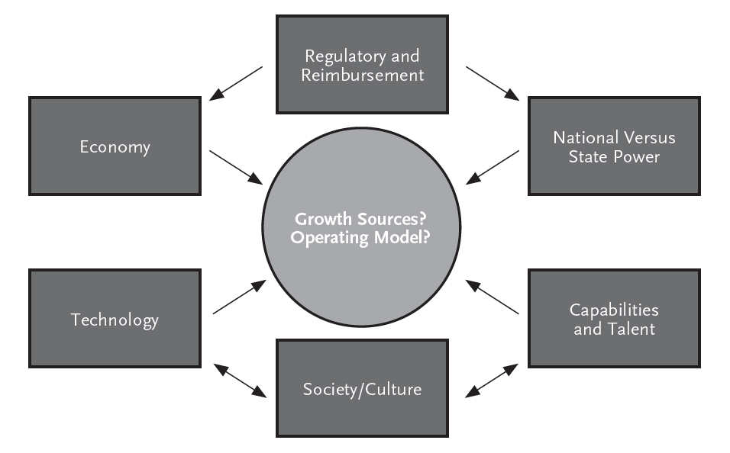
1. Future Uncertainties?
Chapter 3: Strategy Development—Scenario Planning
Notes:
• TECHNOLOGY
a) How has the mobile internet affected our business?
b) How do we ensure the security of the personal data of our customers?
c) How might nanotechnology affect health care and health care insurance? For example, an increasing number of personal medical monitoring devices?
d) Personalized medicine – as it become more available how secure will patients feel in utilizing it?
e) How might global connectivity affect our business? Who could have imagined that Iceland’s financial system would collapse when the real estate market in Las Vegas went belly up?
• CUSTOMERS
a) How is our insurance customer base changing as we move away from reliance on selling insurance products to institutional clients to selling to individual consumers?
• DEMOGRAPHICS
a) What’s the impact of an expanding number of Generation Y adults and diminishing numbers of Gen X’ers and Baby Boomers?

Slide 13
Example: Future Scenarios Facing a Community Hospital
Chapter 3: Strategy Development—Scenario Planning
Care Model
Traditional
Virtual
Opportunity Knocks
All the Young Dudes
Growth
Economy
Recession
Death of the Dinosaurs
Misery

Slide 14
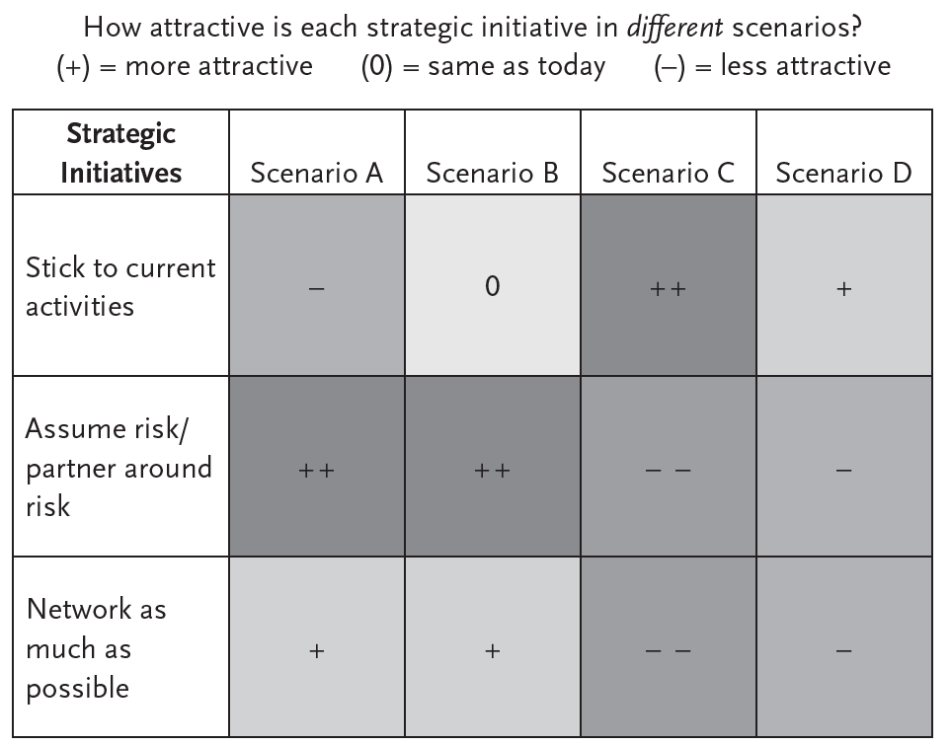
2. Stress Test Current Strategic Initiatives Example
Chapter 3: Strategy Development—Scenario Planning

Slide 15
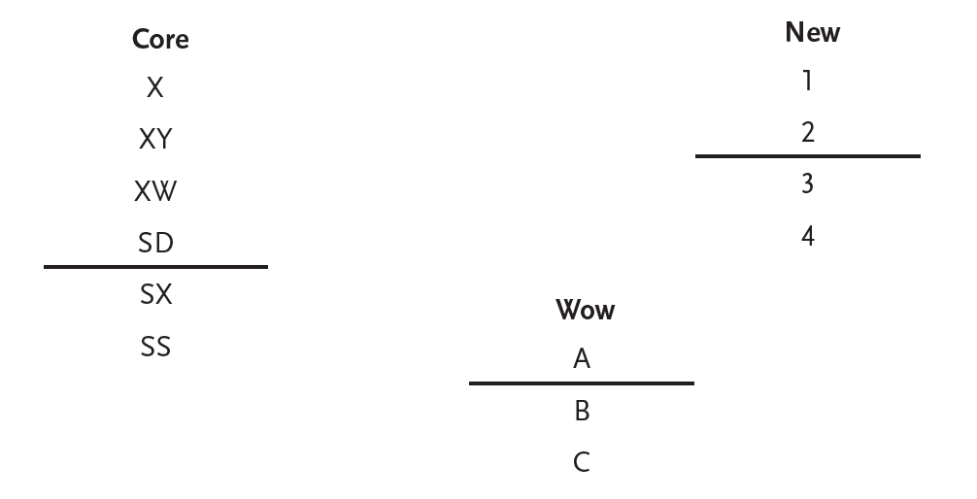
3. Ranking of Strategic Initiatives
Chapter 3: Strategy Development—Scenario Planning
Above line = areas of priority; below line = projects held in reserve

Slide 16
Chapter 3: Strategy Development—Scenario Planning
Summary Questions
List future uncertainties/create scenarios. What social, technological, environment, economic, and political (often referred to as STEEP) forces might dramatically change the operating or external environment?
Challenge existing strategic initiatives. How well will current strategic initiatives perform in different future states?
Create a portfolio of strategic initiatives. What are the most critical strategic investments in the short (Core), medium (New), and long term (Wow)?

Slide 17
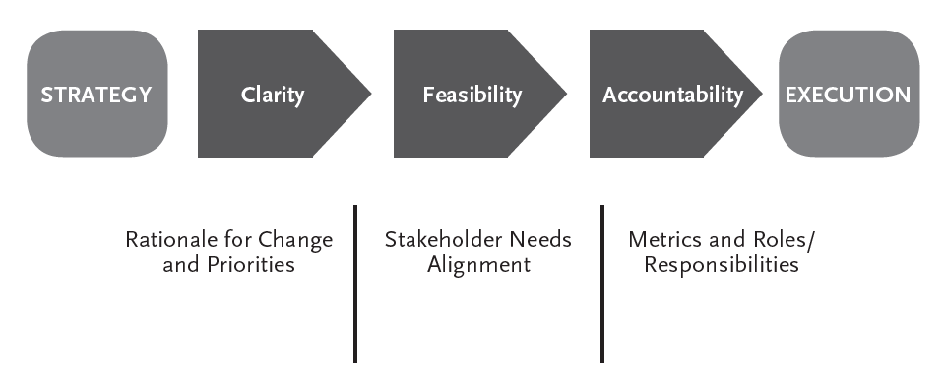
Strategy Execution Process
Chapter 4: Successful Execution

Slide 18
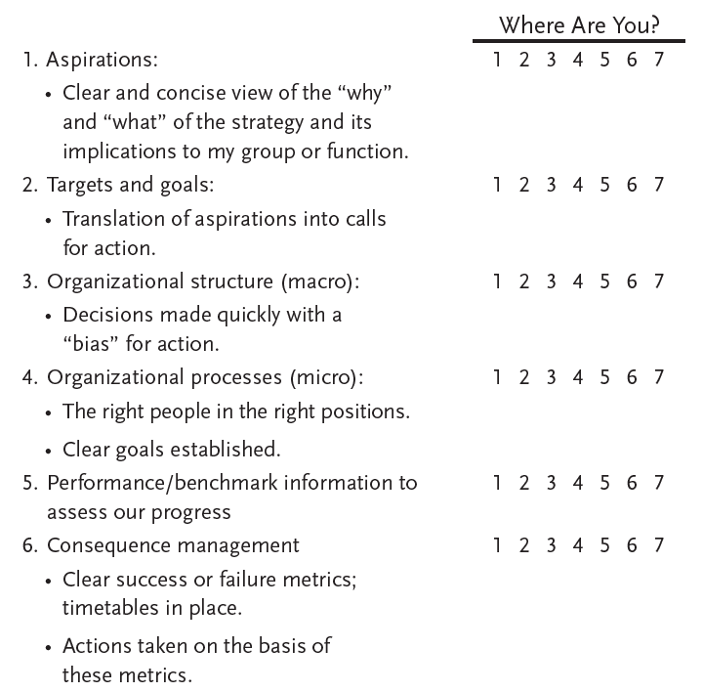
Chapter 4: Successful Execution
Accelerators of Strategic Execution
Source: Prof. Joe Ryan, Wharton

Slide 19
Chapter 4: Successful Execution
Summary Questions
Are the leadership team and the organization execution ready?
Do the vision and strategic priorities guide all employees at an emotional level?
Can the plan evolve?
Are the scoreboards or metrics of success unambiguous?
Is a viable communications plan in place that supports the vision and progress to milestones?
Does the leadership team actively monitor emerging challenges and opportunities, ready to respond as environments change?

Slide 20
Appendix: Indicative Transformative Planning Timeline
Pre-Work
Kickoff Session
1 to 1.5 days
Vision
Initial future scenarios
Session 2
1 Day
Review team portfolios
Begin integration
Session 3
1 Day
Plan integration
Execution roles/metrics
Areas to monitor
Ongoing Plan Reviews and Updates
Working Teams
Major Projects
4 to 6 weeks
Core/New/Wow draft portfolios
Executive Team
Project Integration: Alternative Portfolios
4 to 6 weeks
Financial/operating implications
Execution Teams
Major Projects
Ongoing
Regular communication of progress

Slide 21
Strategic Investment Summary
Appendix: Investment Summary per Major Project
Goal/Scope:
Problem Statement:
Expected Benefits:
Project Management Summary
Major milestones
Anticipated risks/challenges
Project team
Key deliverables

Slide 22
Appendix: Prioritization Details per Major Project
Strategic Initiative Detailed Assessments
 |  |  | Yr 1 | Yr 2 | Yr 3 | Yr 4 | Yr 5 | On-Going? | Total
1) Options for the Future (Describe Actions)
 |  | Aggressive
 |  | Realistic
 |  | Minimal
2) Incremental Investments
 | $
 |  | Aggressive
 |  | Realistic
 |  | Minimal
 | People
 |  | Aggressive
 |  | Realistic
 |  | Minimal
 | Other (Describe)
 |  | Aggressive
 |  | Realistic
 |  | Minimal
3)Financial Returns/Impacts
 |  | Aggressive
 |  | Realistic
 |  | Minimal
4) Other Non-Financial Success Metrics (Describe)
 |  | Aggressive
 |  | Realistic
 |  | Minimal

Slide 23
Thank You!
Health Administration Press
Jim Austin
Adjunct Senior Lecturer
Executive Master of Healthcare Leadership
Brown University
james_austin@brown.edu
jim@jh-austin.com
www.jh-auatin.com
312-388-2750

